Slide 1
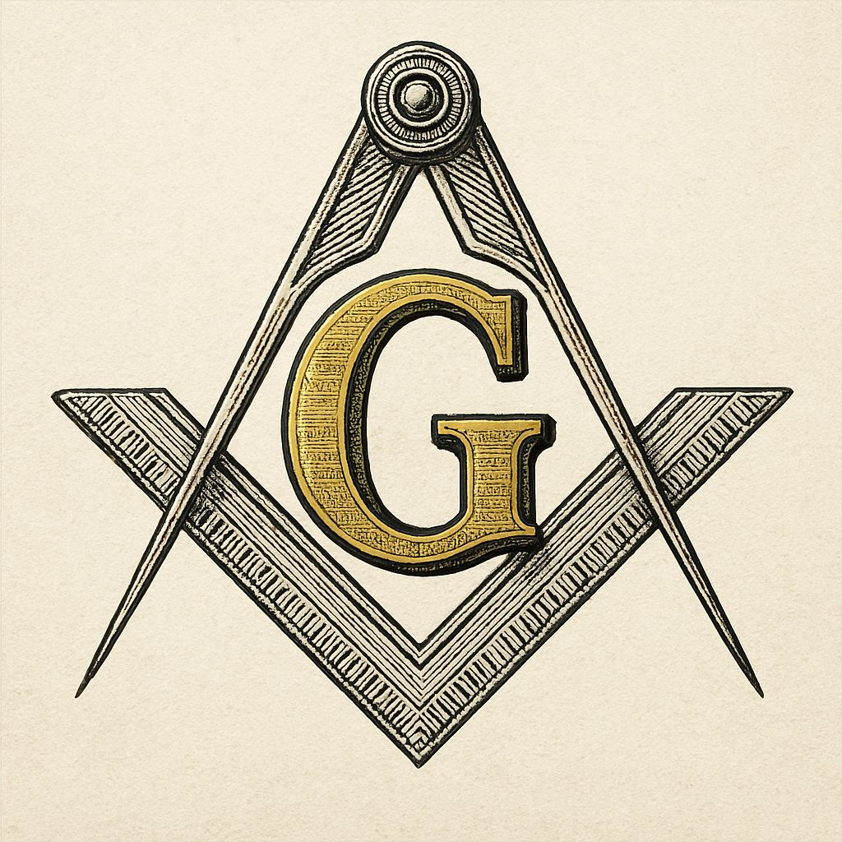
Ethics is the study of morality
Freemasonry educational series
ugle.org.uk
Notes:
Today's presentation is part of the Freemasonry educational lecture series.
I believe this topic isn't discussed enough, so we need to talk about Masonic ethics.
In preparing the present work, I made use of artificial intelligence and its responses during my research.
My aim is to introduce the ethical principles of Freemasonry;
to present the values and rules of conduct of the United Grand Lodge of England (UGLE),
together with the behavioral, mental, and principled foundations it expects;
and finally, to set out the common “moral law” that may be binding upon every Freemason.
Before developing these thoughts, I wish to state that I regard the United Grand Lodge of England’s Book of Constitutions and the official UGLE website (ugle.org.uk) as authoritative.

Slide 2
Ethics is the study of morality
Freemasonry educational series
Freemasonry is not
a religion,
a political party,
a charitable organization
2
Notes:
As the starting point, I would like to talk about what Masonic ethics are really like.
First, however, we must understand what ethics are, and only then can we ask what Masonic ethics is.

Slide 3
What Is Ethics?
Freemasonry educational series
Is the study of morality — the inquiry into what constitutes a good or bad action and character
Greek ethos (“custom, character”) and
the Latin mos/mores (“morals”)
Artificial intelligence
3
Notes:
Ethics is the study of morality — what constitutes good or bad.
The word derives from the Greek ethos (“custom, character”) and the Latin mos/mores (“morals”).
This etymology is telling that ethics has been concerned not only with acts but also a person’s character.

Slide 4
What Is Ethics?
Freemasonry educational series
Metaethics
Normative ethics
Applied ethics
Artificial intelligence
4
Notes:
We highlight the key areas of ethics:
Metaethics — concerns moral statements
Normative ethics — which actions and Which character traits are right
Applied ethics — the application of principles to specific areas, e.g., medicine, business, war, the environment, the media, etc.

Slide 5
What Is Ethics?
Freemasonry educational series
Aristotle:
Morality is found in character.
The central question is: “What kind of person should I become?”
Kant:
Certain actions are right or wrong in themselves, independent of their consequences, because they respect or violate duties and rights.
5
Notes:
Classical philosophy held definite principles on this: e.g.
According to Aristotle, morality is found in character.
The central question is not “What rule should I follow?” but “What kind of person should I become?”
Kant held that certain actions are right or wrong in themselves, independent of their consequences, because they respect or violate duties and rights.
Other philosophers held that people should be judged by the outcomes of their actions:
The right actions are those that produce the greatest good for the greatest number.

Slide 6
The Nature of Masonic Ethic
Freemasonry educational series
Freemasons shape themselves;
their aim is the formation of good character
6
Notes:
If we ask whether Masonic ethics exists, the answer is yes:
There exists a distinctive system of ethical rules pertaining to Freemasonry.
We must proceed with the Masonic tradition.
Its core is that Freemasons shape themselves;
Their aim is the formation of good character.
We must understand that Masonic ethics blended the traditions of medieval stonemasons’ guilds with the values of the Enlightenment.
As a result, Masonic ethics can best be described as a culture.

Slide 7
The Foundations of Masonic Ethics
Freemasonry educational series
A Freemason
Must act with integrity, respect the standards of honor and the law;
Must abide by the laws of the country in which he lives and works;
Must not use his Masonic membership to gain financial, professional, or other advantages for himself or others;
He must respect the views and beliefs of others and refrain from religious or political disputes within the lodge;
He must conduct himself in such a way that his behavior brings no disgrace upon himself or upon Freemasonry.
7
Notes:
The Constitution can be summarized:
A Freemason must conduct himself with integrity,
respect the standards of honor and the law, and abide by the laws of the country in which he lives;
Must not use his Masonic membership to gain financial, professional, or other advantages;
Must respect the opinions and beliefs of others and refrain from religious or political debates within the lodge;
Must conduct himself in such a way that his behavior brings no disgrace upon himself or upon Freemasonry;
follow Masonic principles, the brotherly love, mutual aid, and justice.

Slide 8
The Principal Elements of Freemasonry
Freemasonry educational series
Brotherly Love
Relief (Charity)
Truth
8
Notes:
The moral foundations of English-style “Blue Apron” Freemasonry:
Brotherly love - Every Freemason must be taught to respect the opinions of others.
Charity - Freemasons are expected to care for those in need. This includes organized charity, volunteer work, and personal compassion.
Truth - Freemasons should be encouraged to live honestly. As stated, the expectation is that everyone be a “truthful and trustworthy” person whose word can be relied upon.

Slide 9
The Principal Elements of Freemasonry
Freemasonry educational series
Faith,
obligations,
keeping one’s word
9
Notes:
Additional requirements:
The most important of these are faith, the fulfillment of duties, and keeping one’s word.
The Masonic oath entails certain duties: a Mason assumes certain obligations, from which loyalty, discretion, and reliability follow.
Regular Freemasonry also requires its members to believe in a Supreme Being—the Great Architect of the Universe.
In addition, there are duties that a person must fulfill toward their country, their fellow human beings, and themselves.

Slide 10
The Principal Elements of Freemasonry
Freemasonry educational series
Self-improvement and the shaping of character
The cardinal and theological virtues
The working tools as moral symbols
The exclusion of religion and politics from the Lodge
The Lodge as the centre of union
10
Notes:
Additional important ethical requirements are shown in the slide:
Self-improvement and the shaping of character, and the cardinal and theological virtues.
Working tools as moral symbols.
The square teaches the Freemason to act honestly.
The level teaches the fundamental equality of all people.
The plumb rule teaches uprightness and integrity, the habit of standing morally erect.
The compasses teach the Freemason to keep his desires within bounds and his passions within due limits.
The exclusion of religion and politics from the Lodge. It is an ethical commitment.
The Lodge is the center of union.
It is a requirement that the brethren dress and behave in the Lodge in a way that honors what unites the members, and not what might divide them.

Slide 11
The Values
Freemasonry educational series
INTEGRITY
FRIENDSHIP
RESPECT
SERVICE
The UGLE Values
11
Notes:
The most important values:
HONESTY: The Freemasons strive to become honest people,
FRIENDSHIP: Freemasonry is open to people of all religions and political beliefs and provides a common ground for friendships among members,
RESPECT: Freemasonry brings people together regardless of race, religion, or any other apparent differences that cause division in society.
SERVICE: the very essence of Freemasonry. By offering their time, resources, and skills, they make a valuable contribution.

Slide 12
The Ethical Principles
Freemasonry educational series
The freemasons:
must abide by the laws of the country in question;
must act with integrity in all situations
must keep religion and politics out of the lodge;
must refrain from using their membership for personal financial gain or to obtain advantages;
must practice tolerance—including respect, patience, and kindness;
practice charity in accordance with their financial means;
profess faith in the Supreme Being
The UGLE Values
12
Notes:
Ethical Principles
• They must abide by the laws of the country in question;
• They must act with integrity in all situations—a member must not do anything that would bring Freemasonry or himself into disrepute;
• They must keep religion and politics out of the lodge;
• They must refrain from using their membership for personal financial gain or to obtain advantages;
• They must practice tolerance—including respect, patience, and kindness;
• practice charity in accordance with their financial means;
• profess faith in the Supreme Being.

Slide 13
The Code of Conduct
Freemasonry educational series
The primacy of civic duty
Prohibition against seeking advantage.
Order of Responsibilities
Discretion and Publicity
The Order’s good reputation and neutrality
13
Notes:
The essence of the Code of Conduct:
A Freemason is obligated to obey the laws of the country where he lives and works.
Prohibition against seeking advantage. A member may not use his membership to advance his own or anyone else’s business, professional, or personal interests, nor may he seek advantage or advancement through it. This includes the explicit statement that Freemasonry offers no refuge from the consequences of breaking the law—fraternal bonds may not be invoked as a basis for defense before either the authorities or one’s employer.
Order of Responsibilities. Responsibilities toward family, dependents, work, and community obligations take precedence over commitment to the Lodge.
Discretion and Publicity. A member may disclose his or her own membership but may not disclose the membership of others without their consent.
The Order’s good reputation and neutrality.

Slide 14
The comparison
Freemasonry educational series
UK, USA, Germany, the Netherlands, Hungary, Italy, France, Belgium
Regular | Irregular
Belief in the Supreme Being | Freedom of Conscience
The Book of Holy Law Is Open | A member may be an atheist or a non-believer
Men Only | women's and mixed membership
Prohibition of Politics and Religion, Social debates are possible | Social and political debates are possible
14
Notes:
In preparation for this presentation, I compiled a comparison of ethical concepts across eight countries.
This research reveals that the differences lie not between countries, but between jurisdictions—regular and irregular.
While in the regular obedience’s, faith in the Supreme Being
The Book of the Holy Law is open
They are Men only
Politics and religion are prohibited;
Social debates are permitted,
whereas in the irregular obedience’s. Freedom of conscience
Members may be atheists or non-believers Women and mixed membership Social and political debates are permitted.

Slide 15
The comparison
Freemasonry educational series
Common Ethical Foundations
1. Self-Education
2. Virtue-centered morality
3. Fraternity
4. “Meeting on the level”
5. Tolerance and respect
6. Respect for the domestic legal system
7. Prohibition against seeking advantage
8. Discretion
9. Non-proselytizing, non-recruiting nature.
10. Disciplinary accountability
15
Notes:
Common Ethical Foundations
1. Self-Education symbolized by the shaping of raw stone. Ethics is primarily internal self-regulation, not external compliance with rules. This is the most universal element.
2. Virtue-centered morality taught through symbols. The U.S. codification is the exception.
3. Fraternity as an enforceable duty. Helping one another, supporting the sick, widows, and orphans; the obligation to perform acts of charity has constitutional status everywhere.
4. “Meeting on the level”—by suspending secular distinctions, the lodge is a place where social status, wealth, position, and religious affiliation play no role.
5. Tolerance and respect for the beliefs of others are fundamental norms
6. Respect for the domestic legal system.
7. Prohibition against seeking advantage. Membership may not be used to gain business, professional, official, or political advantage. This appears in the norms of every obedience examined—most explicitly in those of UGLE.
8. Discretion. Protecting the content of rituals and members’ personal data is an ethical obligation.
9. Admission is based on free will; persuasion or the exertion of pressure is unethical.
10. Disciplinary accountability Dishonesty, lying, and unfair treatment of a brother are offenses everywhere.

Slide 16
The comparison
Freemasonry educational series
UGLE Code of Conduct
Constitution and Statutes of the Grand Lodge of Free and Accepted Masons of the State of New York, with Digest of Decisions and Resolutions … and an Appendix, Containing the Ancient Charges, Rules of Order, Forms, Code of Procedure and Legislative Acts.
16
Notes:
Let’s look at the two countries that are most relevant to us. In England, there are uniform rules. In the U.S., the rules vary by state. At UGLE, the Code of Conduct is the document that members receive. In New York, the members learn about ethical standards through the ritual, and from the Rules of Procedure, they learn what the consequences are for violating them.

Slide 17
Ethical Standards of Freemasonry in New York State
Freemasonry educational series
Offenses:
breaking an oath and betraying ritual secrets
deceiving, defrauding, or robbing a brother; engaging in business dishonesty toward a brother
slandering a brother, making baseless accusations
offending a brother’s family (historically emphasized item)
using membership to gain advantages—for business, professional, or political purposes
drunkenness, conduct contrary to public morals that brings the Order into disrepute
bringing religious and political issues into the lodge
disobedience to the laws of the Grand Lodge or the orders of the lodge master
17
Notes:
The figures show the offenses investigated by Freemasonry in New York State:
I would like to highlight breach of the oath, betrayal of ritual secrets, but offenses also include
deceiving a brother, bringing him into disrepute, insulting his family, and drunkenness.
.

Slide 18
Ethical Standards of Freemasonry in New York State
Freemasonry educational series
American Freemasonry
is regular
it is recognised by the UGLE
requires belief in a Supreme Being,
keeps the Volume of the Sacred Law open upon the altar,
and excludes religious and party-political dispute from the Lodge.
18
Notes:
From an ethical standpoint, American Freemasonry is regular. Recognized by the UGLE, its members acknowledge the Great Architect of the Universe, keep His Book of Laws open on the altar during their work, and exclude religious and political debates from their discussions.

Slide 19
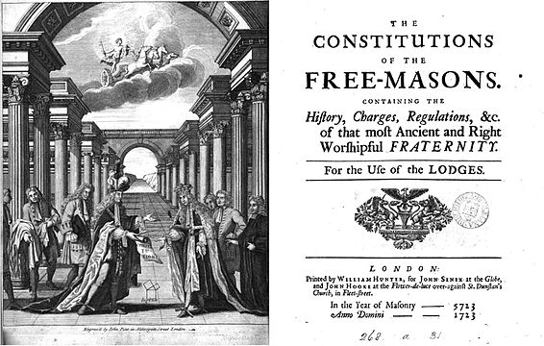
Freemasonry educational series
„To make good men better.” Brotherly Love, Relief, and Truth
19
Notes:
British and American Masonic ethical principles are identical. Masonic ethics constitute a culture of morality. Masonic ethics are based on the principles laid down in James Anderson’s 1723 Constitutions.
The aim of Freemasonry expressed by its motto is to admit good people and then, through patient, lifelong work, help them become even better.

Slide 20
Freemasonry educational series
ORATORS.INFO
https://orators.blog/
https://orators.blog/2026/07/25/the-ethics-is-the-study-of-morality/
20
Notes:
If you would like more information, I recommend reading the edited version of this presentation on the ORATORS.INFO website.

